Slide 1
FindMe
Chiranthan Mirle - 1001011399
Abhishek Agarwal - 1000987331
Ranjith M A - 1000969864
Ather Mohammed - 1000993284
Bhavana Nandyala - 1000859140

Slide 2
Vision
To build an interactive, new generation search assistant which helps us find people and places through the touch of a button (Most accurate for outdoors).

Slide 3
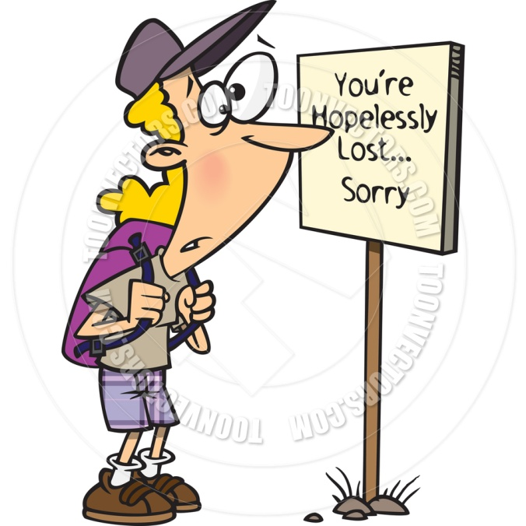
Where am I?

Slide 4

Where's my friend?

Slide 5

Solutions to the problems
To reach a destination you need two parameters

Slide 6
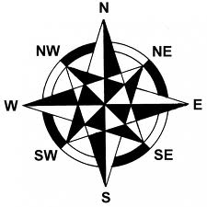
Direction
To know where you are and to proceed to your destination

Slide 7

Distance
After learning the direction, how far should you travel in that particular direction?

Slide 8

I Will use “FindMe”

Slide 9
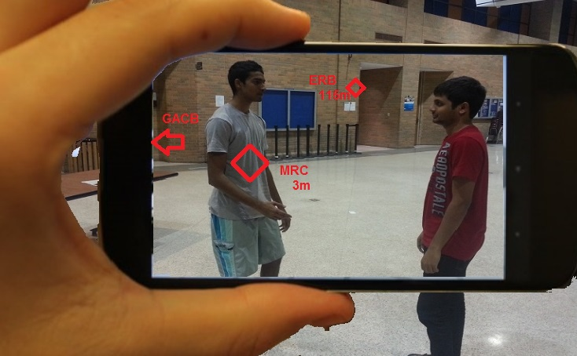
Now this is just what I want!!!

Slide 10

What tools do we use?

Slide 11
Tools that help us in development

Slide 12

GitHub

Slide 13


Android Development Tools
With AVD

Slide 14
Omega Server
omega.uta.edu

Slide 15
How does the device support us?

Slide 16

Camera

Slide 17



Slide 18

Compass

Slide 19
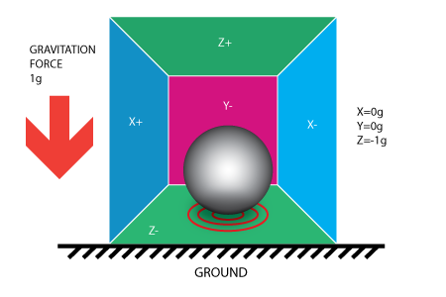
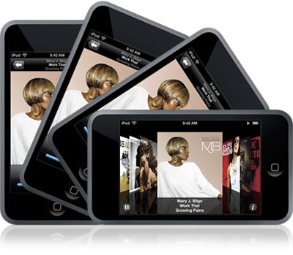
Accelerometer

Slide 20
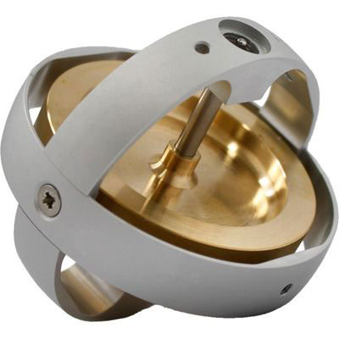
Gyroscope

Slide 21
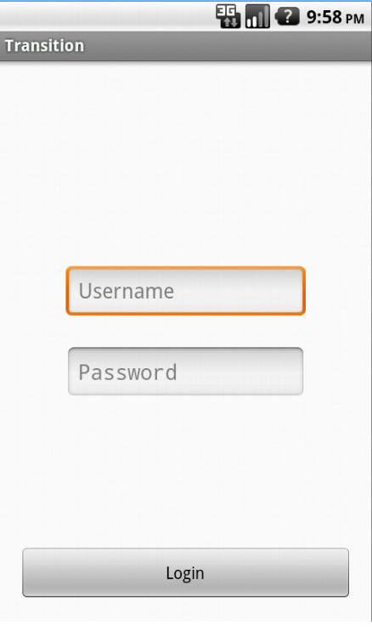
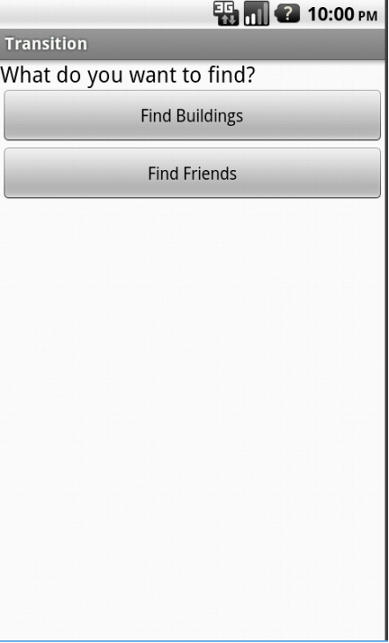
Inputs

Slide 22
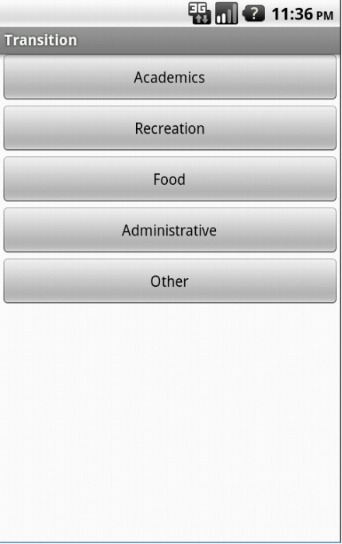
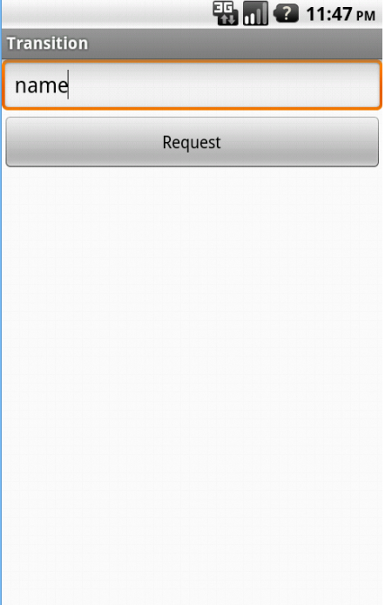

Slide 23
Output

Slide 24
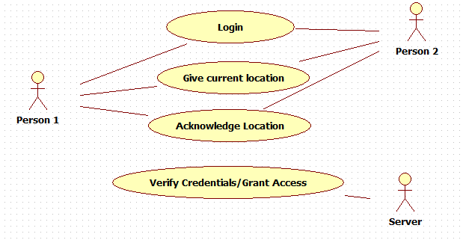
Basic Use Case Model

Slide 25
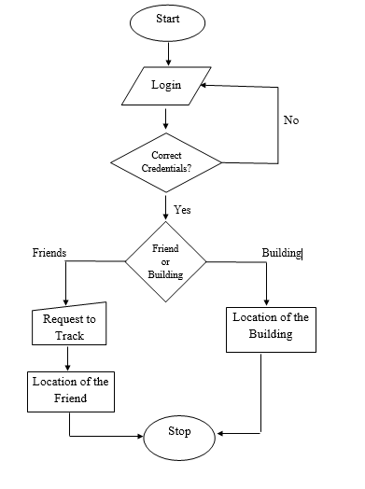
Flow Chart

Slide 26



Risks
Security
Oops!! Wrong Person
Accuracy of GPS

Slide 27

Risk Management

Slide 28
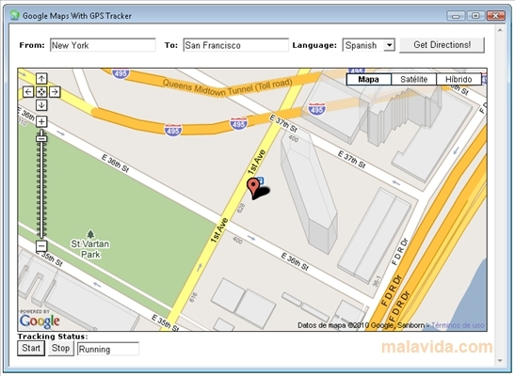

COMPETITORS
Google Maps
AcrossAir

Slide 29
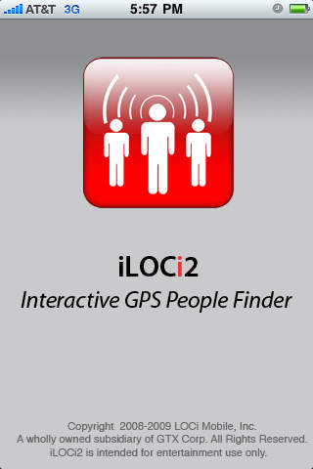
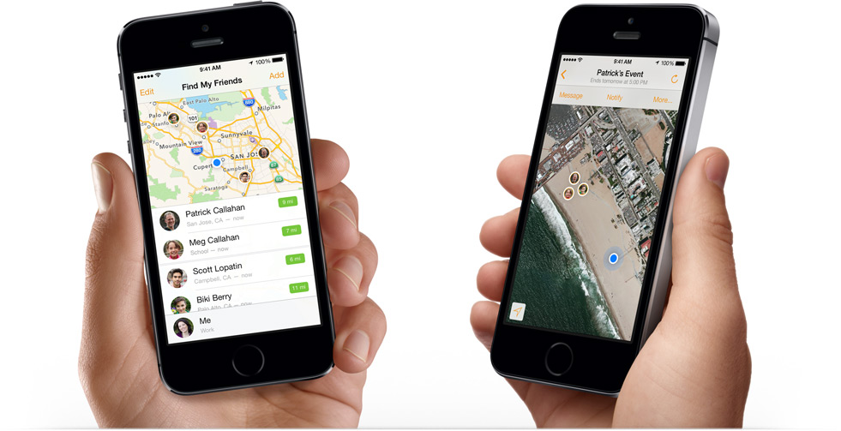
Find my Friends
iLOCi2

Slide 30
FUTURE SCOPE
New students can explore!
Can go global.

